Slide 1
Maintenance of traffic

Slide 2
Outline
Coordination
Notifications
UPA Issues
Subcontractors and Delaware guidelines
Considerations for MOT providers
Frequent errors
Pedestrian issues
Questions
Notes:
Coordination: What needs to happen prior to permitting, review and implementation in the field.
Notifications: Who needs to be notified, when they do and what they need to be notified of.

Slide 3
Coordination
Prior to Utility Permit Submission
If there is a question about MOT contact the utility section and traffic safety.
Prior to Capital/Advanced Relocations
These will have a set of approved MOT plans, any changes or modifications that need to happen can be coordinated with the traffic safety office & construction staff.
These projects will be subject to the same time and traffic restrictions as the main project. These need to be referenced before work begins.
Adjacent project
Any road work, construction & MOT working within the same area will have to be coordinated. This will insure there is not overlap, conflict or issue with DEMUTCD compliance.
Notes:
-Prior to, we are more than willing to help guide in the correct direction so there isn’t any hold up or back & forth in the upa.
-Capital: We have already completed an extensive review for the timing and the traffic control needed in this area. Typically, all restrictions will be upheld, but small modifications can happen.
-Adjacent work areas have always been an issue, especially with daily utility work. They need to set up the proper MOT and signage so its compliant and makes sense to the traveling public.

Slide 4
Notification
Traffic Safety Personal
North District:
Jimmy Maust – 302-222-5997
Canal District:
Curtis Davis – 302-358-0376
Central District:
Bobby Johnson – 302-502-1514
South District:
Dan Thompson – 302-300-6639
Any Work within the state ROW
TMC notification on daily activities when they are set in place, and when they are removed. 302-659-4600
Utility sections Public Works / Capital
Notes:
-TMC notification to let them know what is going on in the road, what is affected, duration, contact person and a call back at the end of the day to let them know that the area is clear of construction activities, or the condition the area will be left in.
-Utility Sections / Capital: For them and their information. We “Traffic Safety” Get a lot of information from the inspectors and coordinate with them on issues in the field.

Slide 5
Common Issues Upa
Typical application submission:
There is a specific tab just for typical applications for traffic control to be added into the UPA. Often these are left blank or added in the incorrect location.
Old case numbers are still being submitted, the submitted TA needs to be referencing the current DEMUTCD
Permits are submitted with the same common TA’s for every submission from a utility provider.
Notes:
-When submitting a safety permit in the (UPA)-Utility Permit Application under Typical Traffic Applications; Please provide the TA you will be utilizing. A lot of times this is left blank, or it Is placed in the wrong location within the permit.
-DE CO-OP always submits ta3 & 10, even if they don’t apply. Its helpful to have the person submitting for the permit to have a working knowledge of what the field work will entail and the MOT needed to support it.

Slide 6
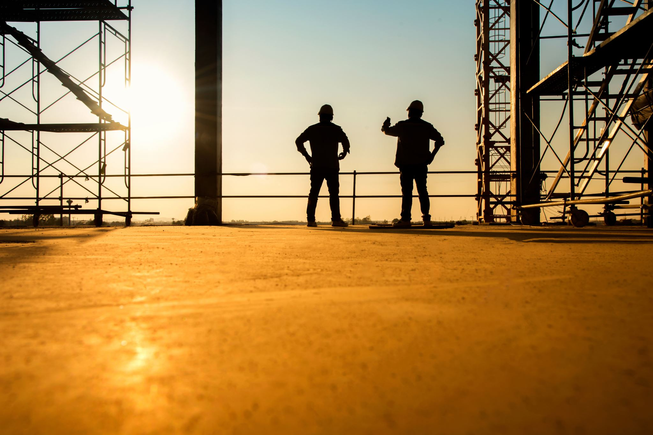
Subcontractor Issues
Out of state sub contractors are not familiar with Delaware specific requirements.
DEMUTCD
Contract guidelines
Time restrictions
Field issue resolution
Who is the point of contact
Pass the blame
The correct person that can make the change.
Notes:
-Out of state: They are used to working in other states that my follow just the federal standards. In Delaware we have our own version on the MUTCD in which we go above the typical standards.
-just look at the permit, and not the notes or anything else to see if there is anything specific in relation to the MOT
-Time restrictions may not me known, or they may be disregarded as they have more focus on that actual work getting completed.
-Field issues: There never seems to be an available point of contact for MOT issues. When there is a out of state sub on a larger project there has been times where there is a lot of confusion on who is and can direct MOT subs
-Is it the Sub contractor who oversees that, is it the inspector from the utility company that is on site, is it the engineer from the utility?
-This is typically seen when a sub contractor uses a MOT sub contractor. There seems to be a lot of players in the game and the information may be getting lost or not passed to the correct person.

Slide 7
Considerations for MOT subcontractors
Information exchange
Let the MOT Sub know of the operation and the needs.
Will the work move or change the mot requirements
Timing needed for the work in the field.
Responsibility
It’s ultimately the utility that is doing the works responsibility to ensure that the MOT is set up and maintained correctly.
Notes:
-Information exchange
-What needs to happen for the work, shoulder/sidewalk/lane closures. They need to make sure that they show up with all the proper equipment to do the job correctly. There have been times where the workzone is incorrect because the scope of the traffic control has changed, but they proper equipment isn’t there on site and the utility contractor will continue to work.
-Timing and duration is important because of the standards that we have. If work will take place at night, then different devices are needed.
-Responsibility
-it doesn’t matter how many sub contractors are in the line, or who is picked to be in charge of the MOT on that site. At the end of the day it’s the permittees responsibility to make sure that all the MOT is in place correctly. If its not, this can result in the work being suspended until MOT issues can be resolved.

Slide 8
Frequently seen errors
Work zone coordination.
Overlapping signage is an ongoing issues.
Smallest work zone on the road, or able to be avoided with communication?

Slide 9
Frequently seen errors
Flaggers
Not being certified in Delaware.
Some states follow just the federal standard, we require flaggers certified in Delaware through an approved program such as ATSSA

Slide 10
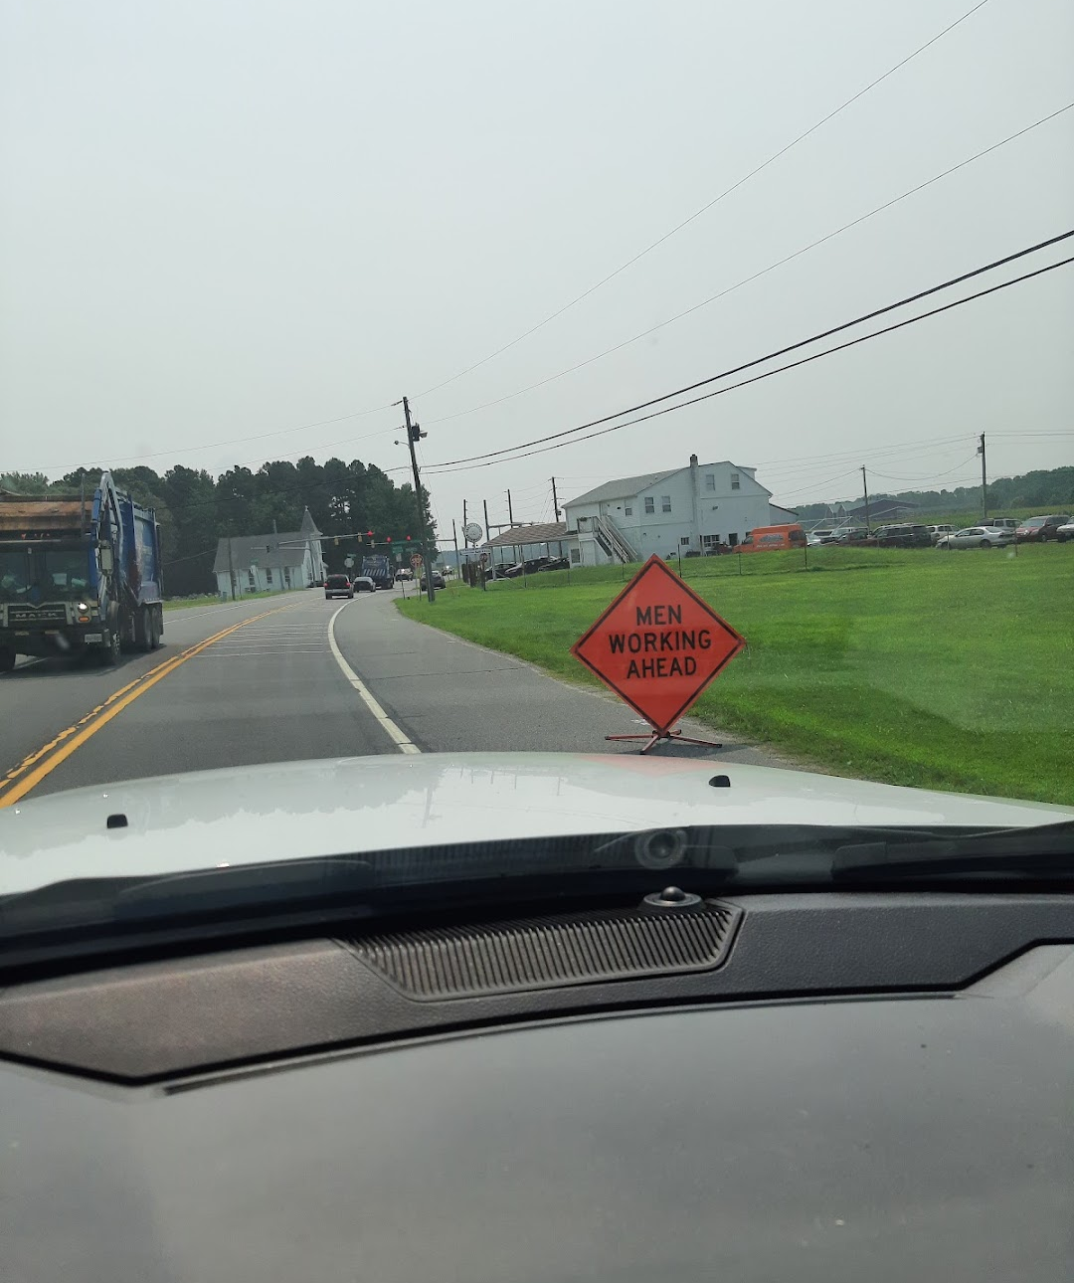
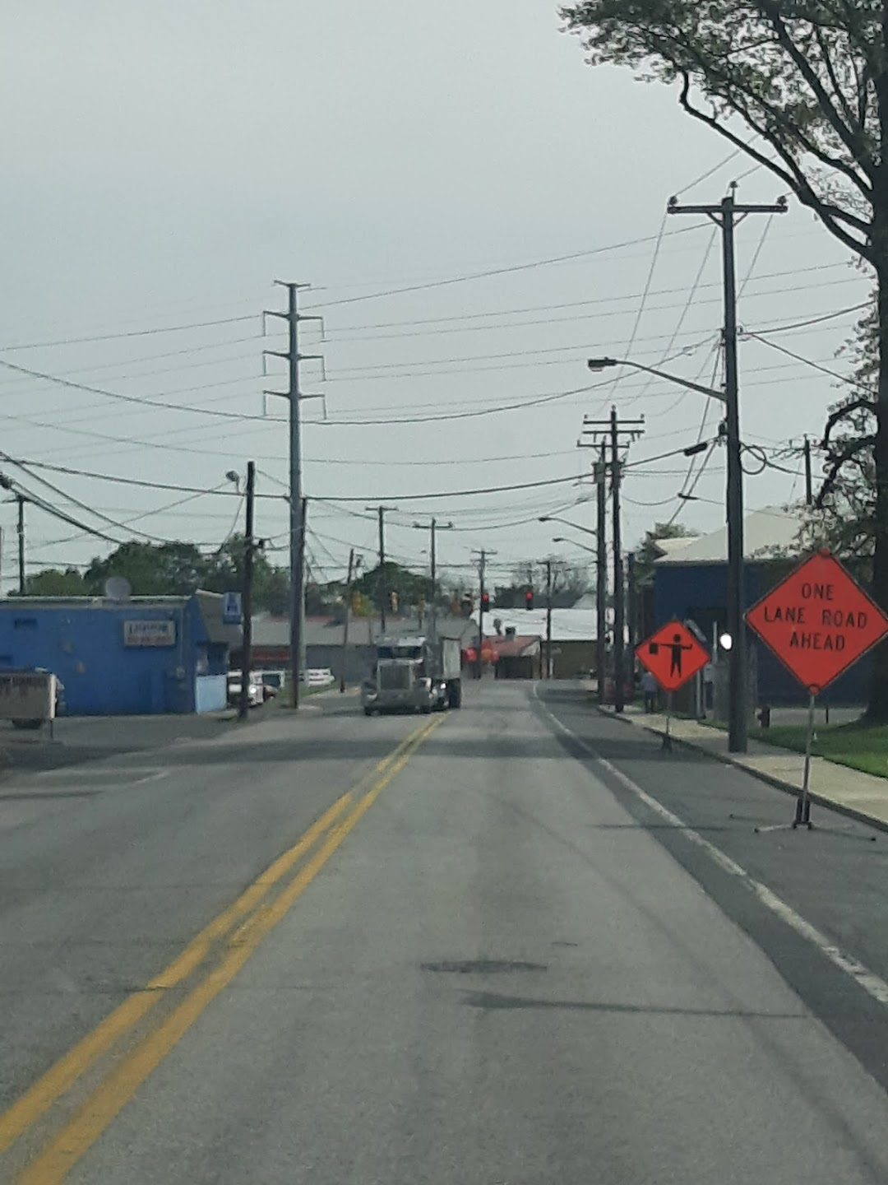
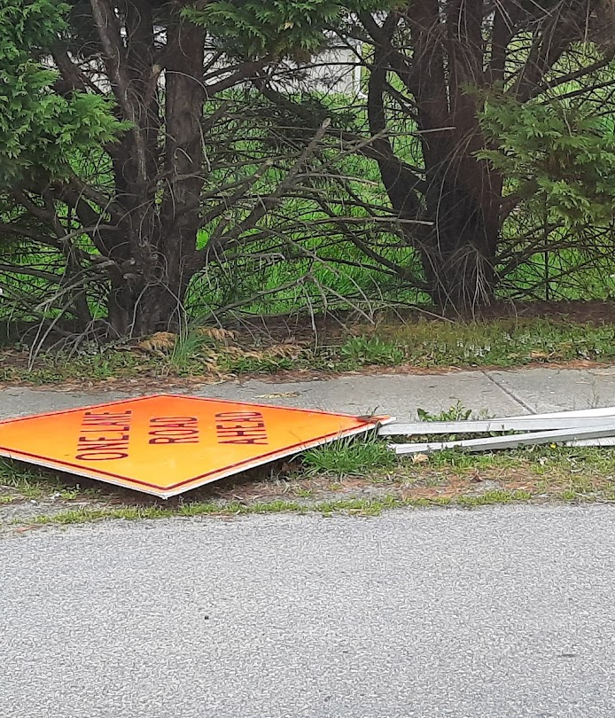
Frequently seen errors
Signage
Incorrect height, 5’ from the bottom of the sign to the top of the road surface.
Incorrect spacing for the roadway or typical application.
Being stored within the right of way while not in use.

Slide 11
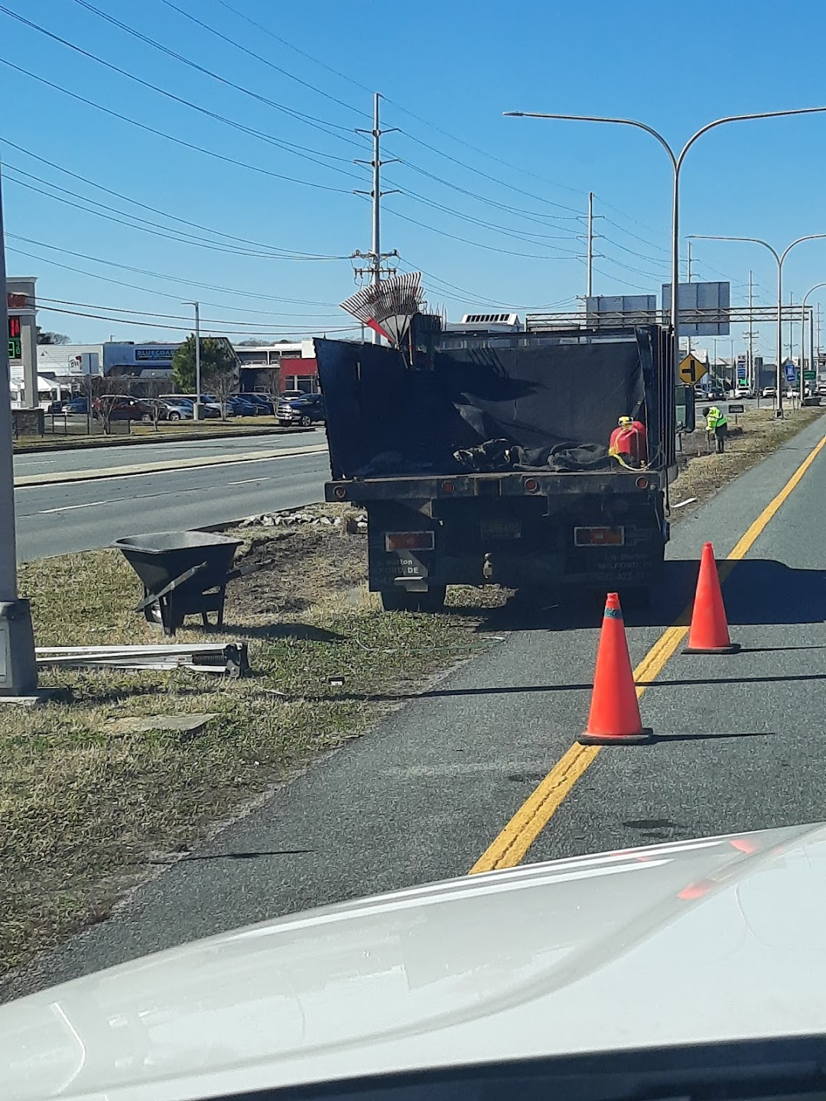
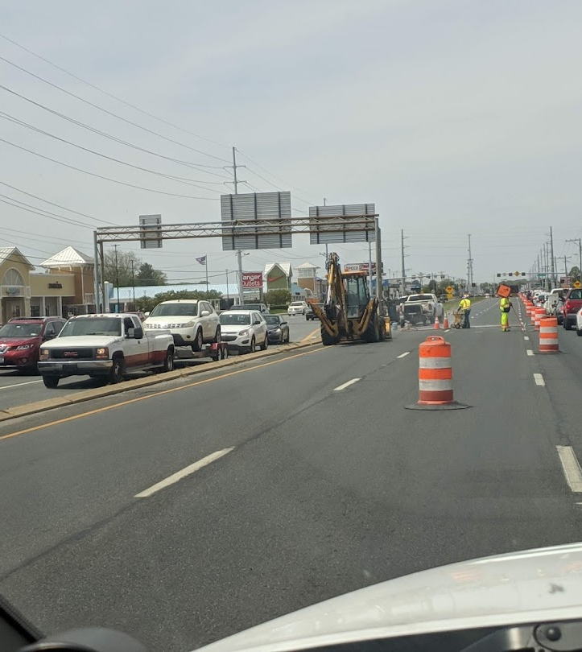
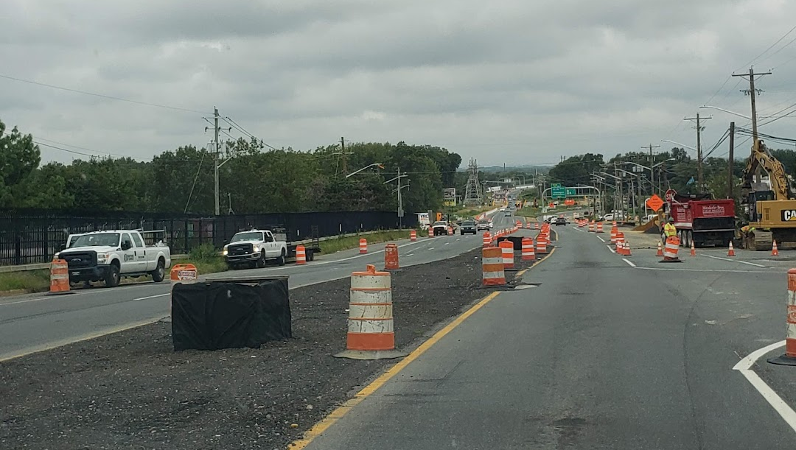
Frequently seen errors
Devices
Damaged, dirty and/or non-compliant
We follow ATSSA quality guidelines
Incorrect spacing between devices
Based on the speed limit of the roadway
Incorrect taper lengths and spacing
Based on the type of set up shift/closure, the roadway speed and the width of the shifted area.

Slide 12
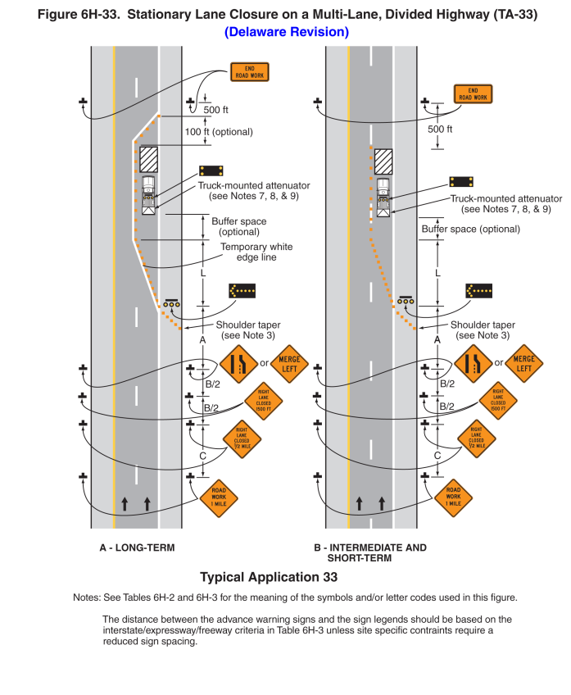
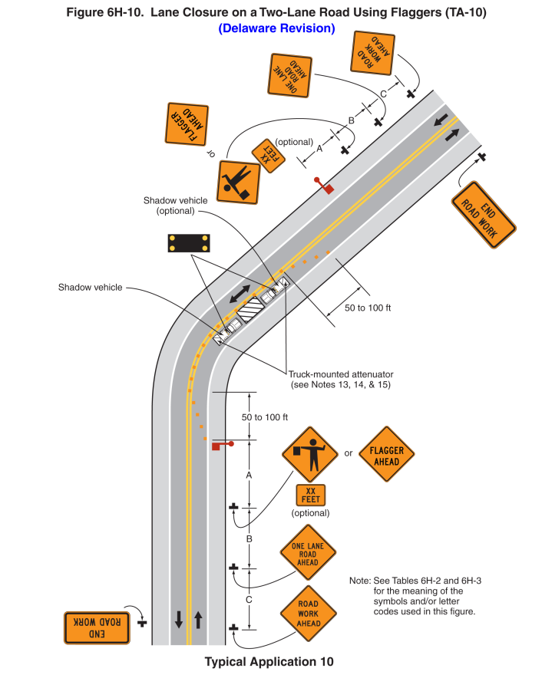
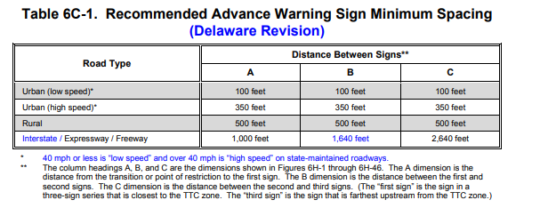
Typical application & Calculations

Slide 13
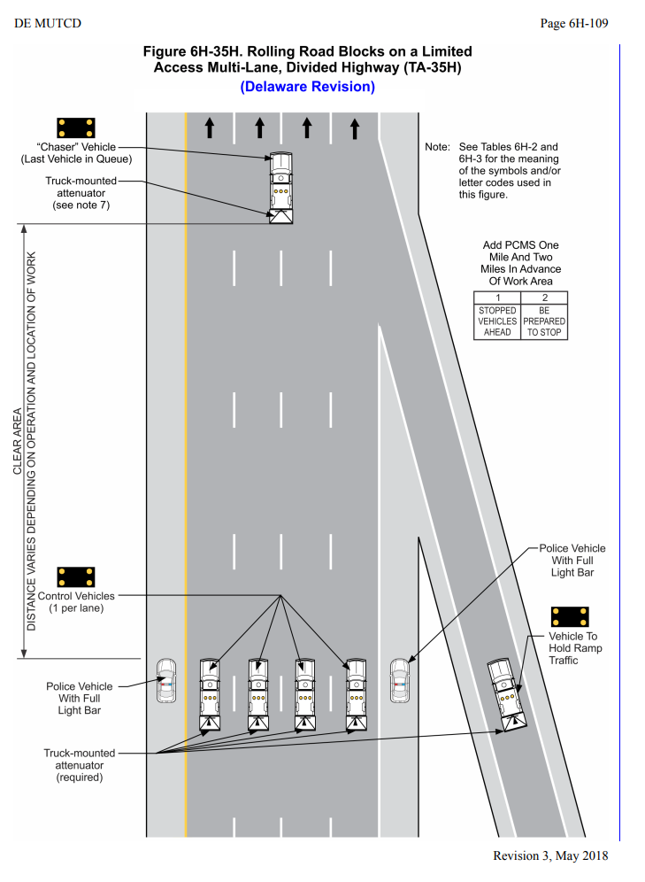
Rolling roadblock
Special cases where all lanes needs to be stopped temporally.
Mostly seen on ariel crossings over major roadway
These need to be per approved and they need to be coordinated with traffic safety.

Slide 14
Pedestrian issues
Pedestrians are treated the same way as a vehicle. If there is a facility on site, then it needs to be maintained.
Its important to know the area you're working in; this can become tricky.
Pedestrian detours can be used
If they are taken away from the typical sidewalk, approved materials and special devices may be required to create a path.
Pedestrian flagging can be utilized if needed, this has worked well in the past.

Slide 15
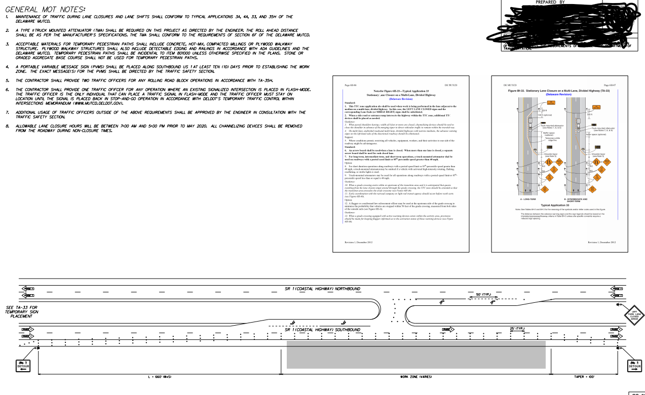
Specific MOT for pedestrians/bikes
There has been MOT created for working in an area where the shoulder is actually a bike/PED lane.
This involves closing a lane of traffic and placing the bike/peds into that closed lane and channelizing them with specialty signage.

Slide 16
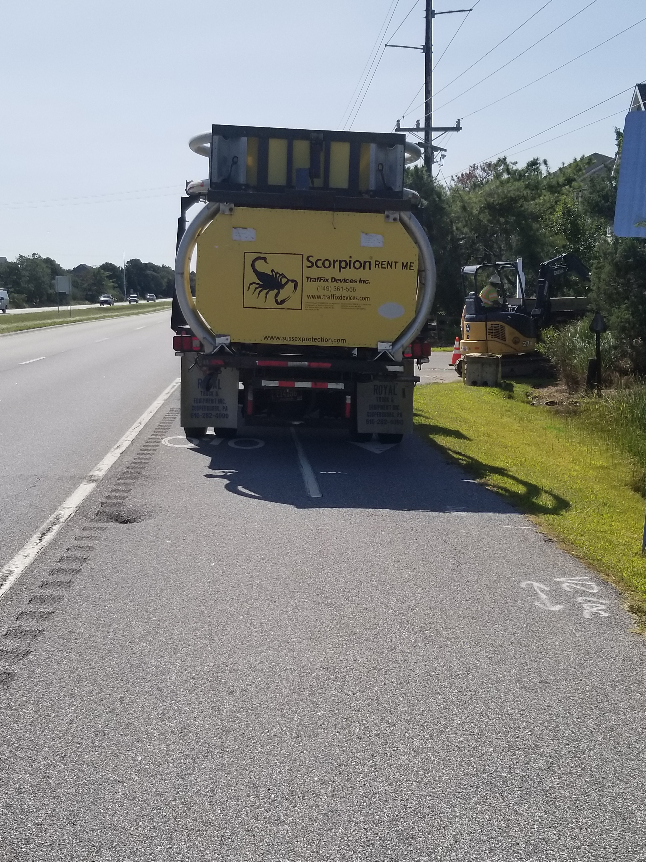
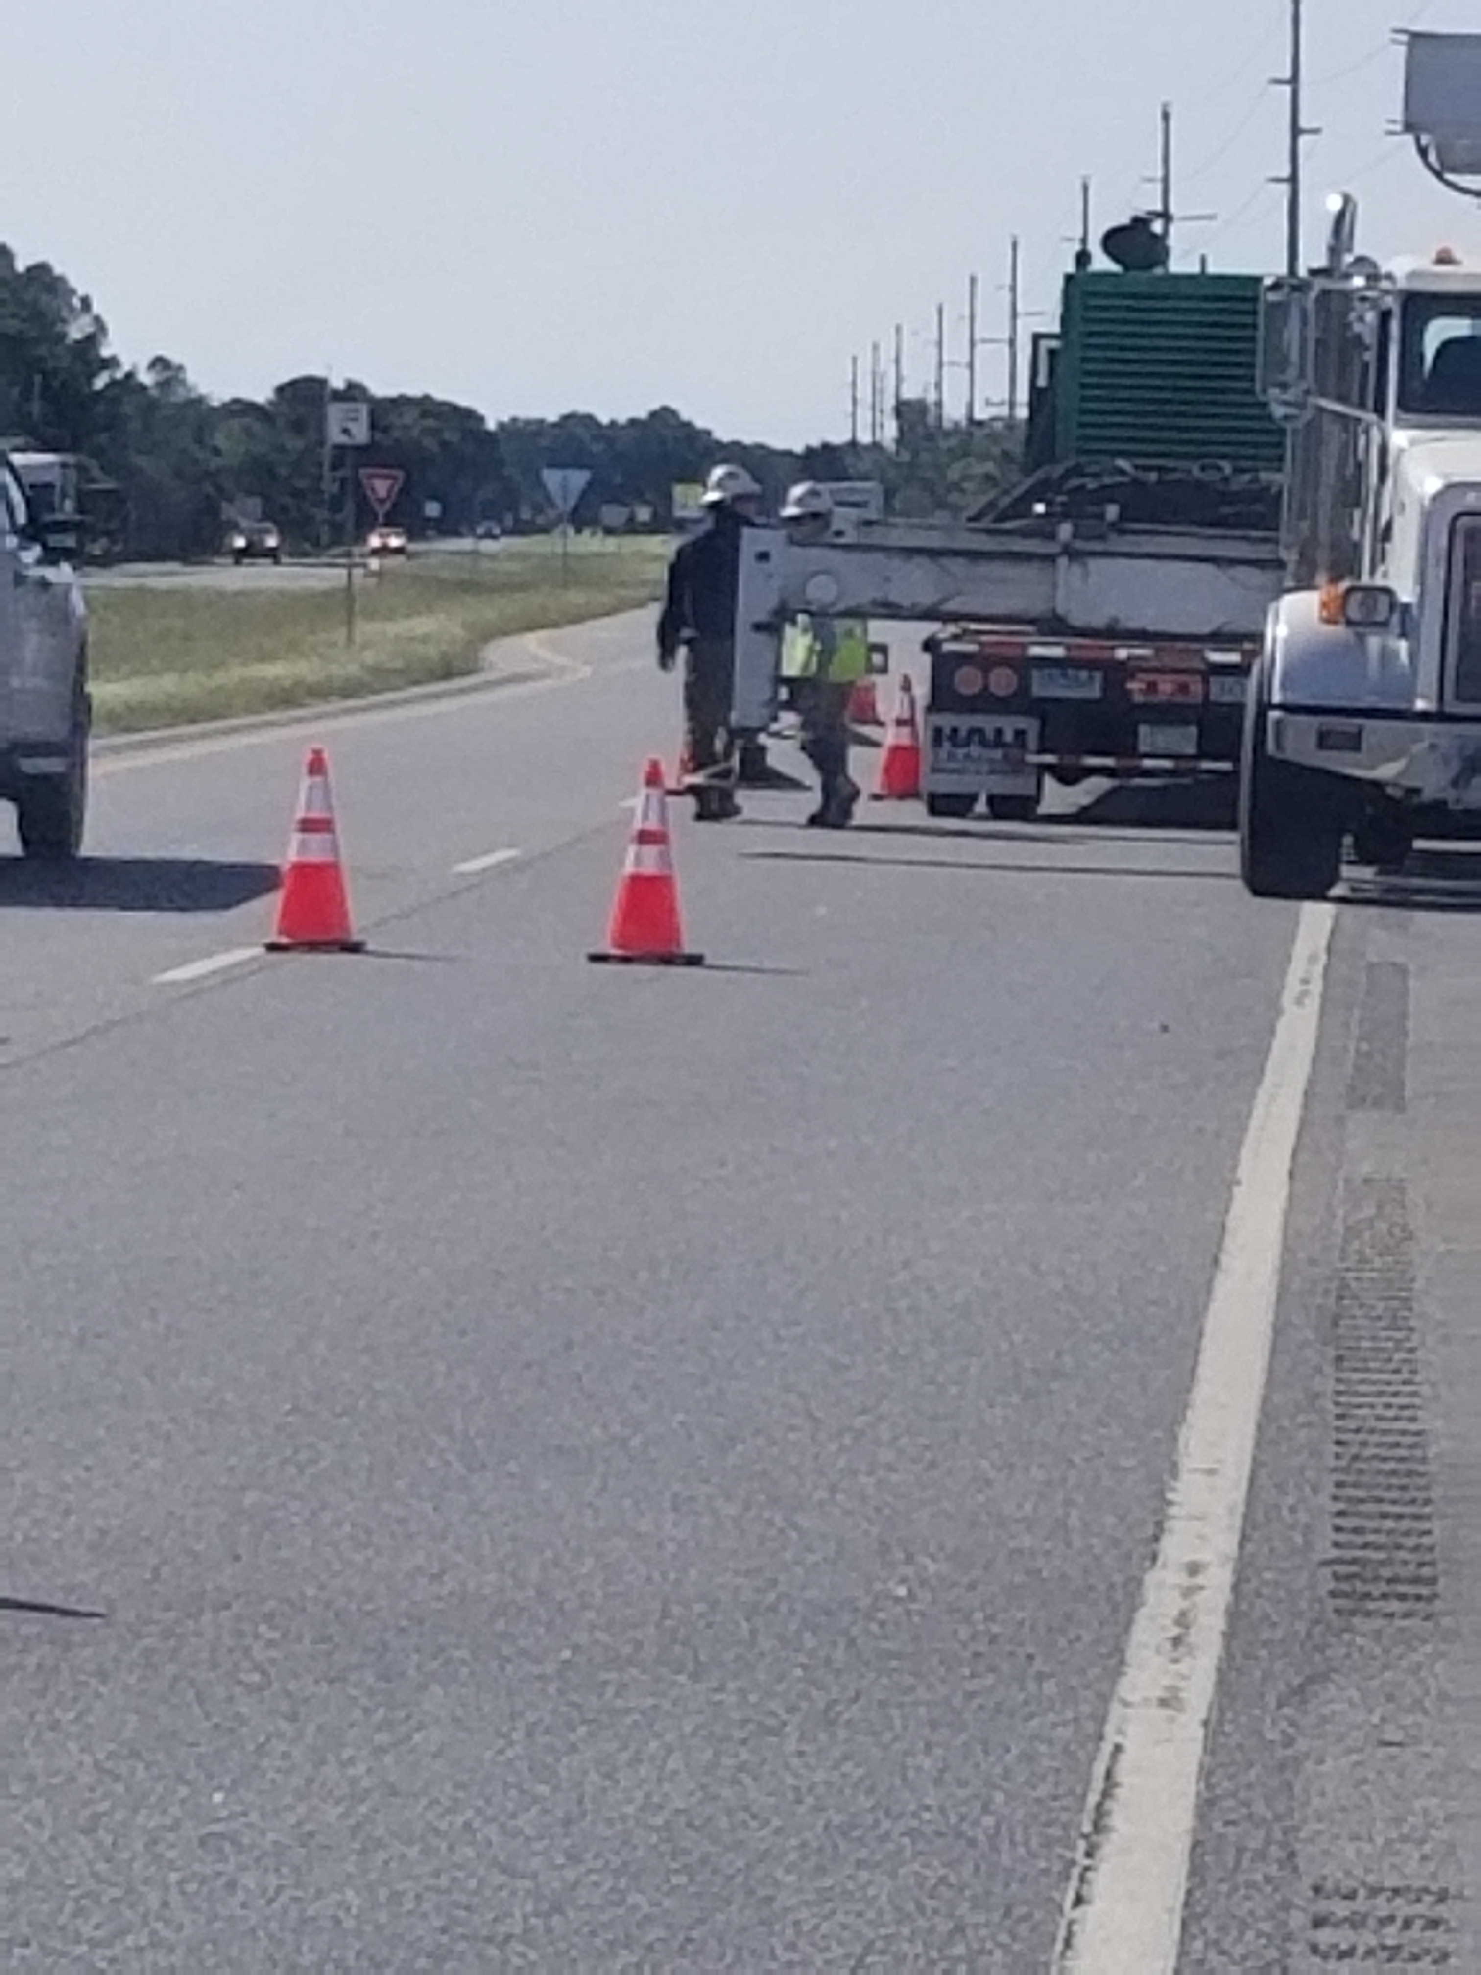
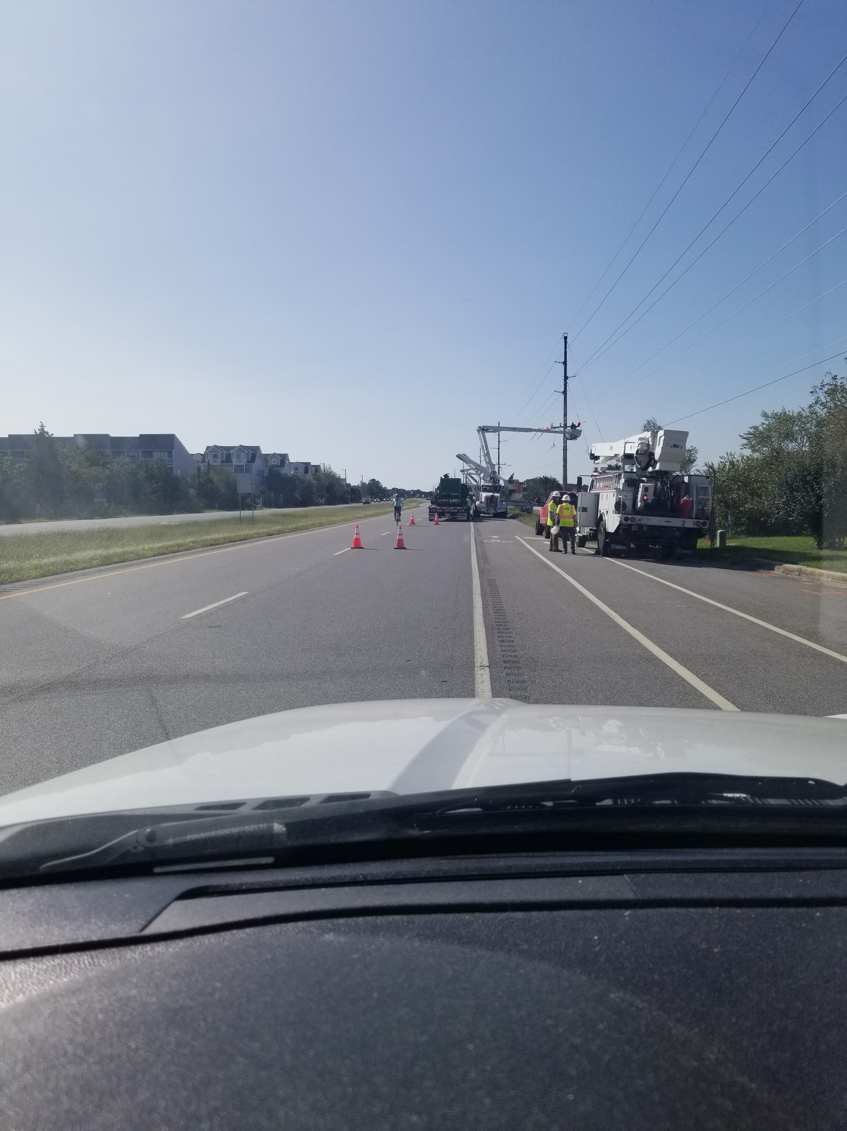
Specific MOT for pedestrians/bikes
Pedestrians and Bikes must be maintained
Once the MOT is in place, it must remain unobstructed just as an open lane of traffic would be.

Slide 17
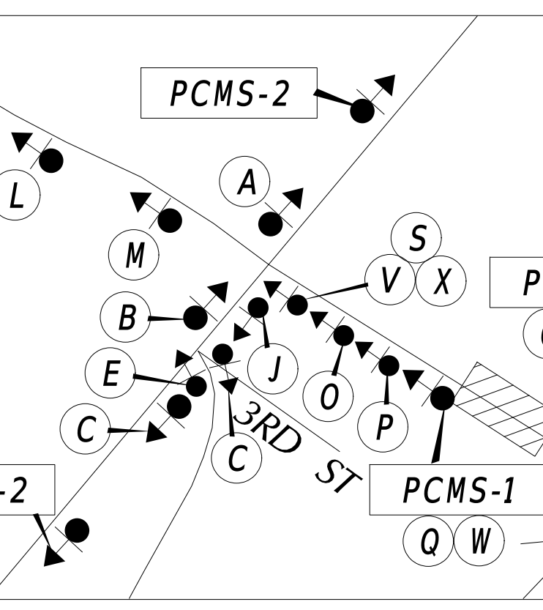
Detour design & Approval
Detours must be submitted to traffic safety for review and approval
Must be on our boarder with our legend.
Must be signed and sealed by an engineer.
Needs to be added into the UPA for that permit.
The project manager (DelDOT) needs to submit the road closure form along with the signed detour.
Once the above is completed the traffic safety officer for that district will approve the road closure.
Contact for detour review submissions:
David Wynn: David.wynn@delaware.gov

Slide 18
questions

